Slide 1

Academic Session 2025-26
ODD Semester Jul-Dec 2025
UNIVERSITY INSTITUTE OF ENGINEERING
COMPUTER SCIENCE ENGINEERING
Bachelor of Engineering
Semester: 6th
Design and Analysis of Algorithms
(23CSH-301/ITH-301)
Unit No. 1 Chapter No. 2 Lecture No. 9
Topic : Hashing
Richa Dhiman E11307 Assistant Professor

Slide 2
1
Learning Objectives & Outcomes
Objective:
To understand the meaning of Hashing and its technique.
Outcome:
Student will understand
Importance of Hashing
Techniques of hashing

Slide 3
2
Hashing
Hashing is a well-known technique to search any particular element among several elements.
It minimizes the number of comparisons while performing the search.
An array data structure called as Hash table is used to store the data items.
Based on the hash key value, data items are inserted into the hash table.

Slide 4
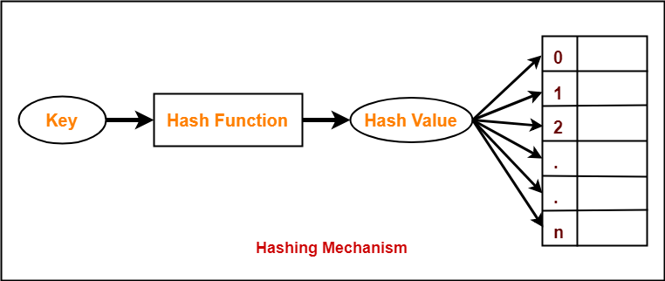
3
Hashing

Slide 5
4
Types of Hashing
Mid Square Hash Function
Division Hash Function
Folding Hash Function

Slide 6
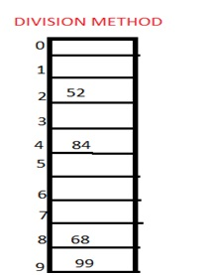
5
Division method
In this the hash function is dependent upon the remainder of a division. For example:-if the record 52,68,99,84 is to be placed in a hash table and let us take the table size is 10.
Then:
h(key)=record% table size. 2=52%10
8=68%10
9=99%10
4=84%10

Slide 7
6
Mid square method
In this method firstly key is squared and then mid part of the result is taken as the index. For example: consider that if we want to place a record of 3101 and the size of table is 1000. So 3101*3101=9616201 i.e. h (3101) = 162 (middle 3 digit)

Slide 8
6
Digit folding method
In this method the key is divided into separate parts and by using some simple operations these parts are combined to produce a hash key. For example: consider a record of 12465512 then it will be divided into parts i.e. 124, 655, 12. After dividing the parts combine these parts by adding it.
H(key)=124+655+12 =791

Slide 9
Applications
7
Data retrieval using hash tables
Database indexing
Symbol tables in compilers
Password storage (secure hashing)
Cryptography and digital signatures
Checksums and file integrity verification
Cache implementation (web and database caches)

Slide 10
17
Summary
Introduction to Hashing
Key values
Types of Hashing
Mid Square Hash Function
Division Hash Function
Folding Hash Function

Slide 11
18
Next Lecture
- Heaps and Graphs

Slide 12
19
Quiz
What is the main purpose of hashing? A) Sorting data B) Compressing data C) Fast data retrieval D) Encrypting data
Which of the following is a common hashing technique? A) Merge Hash B) Modulo Division C) Stack Hashing D) Sequential Mapping

Slide 13
20
References/ Articles/ Videos
Text books:
Cormen, Leiserson, Rivest, Stein, “Introduction to Algorithms”, Prentice Hall of India, 3rd edition 2012. problem, Graph coloring.
Horowitz, Sahni and Rajasekaran, “Fundamentals of ComputerAlgorithms”, University Press (India), 2nd edition
Websites:
https://www.gatevidyalay.com/hashing/
https://www.includehelp.com/data-structure-tutorial/hashing.aspx

Slide 14
21
Faculty-curated videos, NPTEL, Coursera, LinkedIn, or other relevant learning resources
https://onlinecourses.nptel.ac.in/noc23_cs96/preview
https://nptel.ac.in/courses/106106131
https://nptel.ac.in/courses/106106208
https://www.linkedin.com/learning/learning-algorithms

Slide 15
23
Class-Wise Feedback

Slide 16
24
Thank You
For queries
Email: richa.e11307@cumail.in

